Slide 1
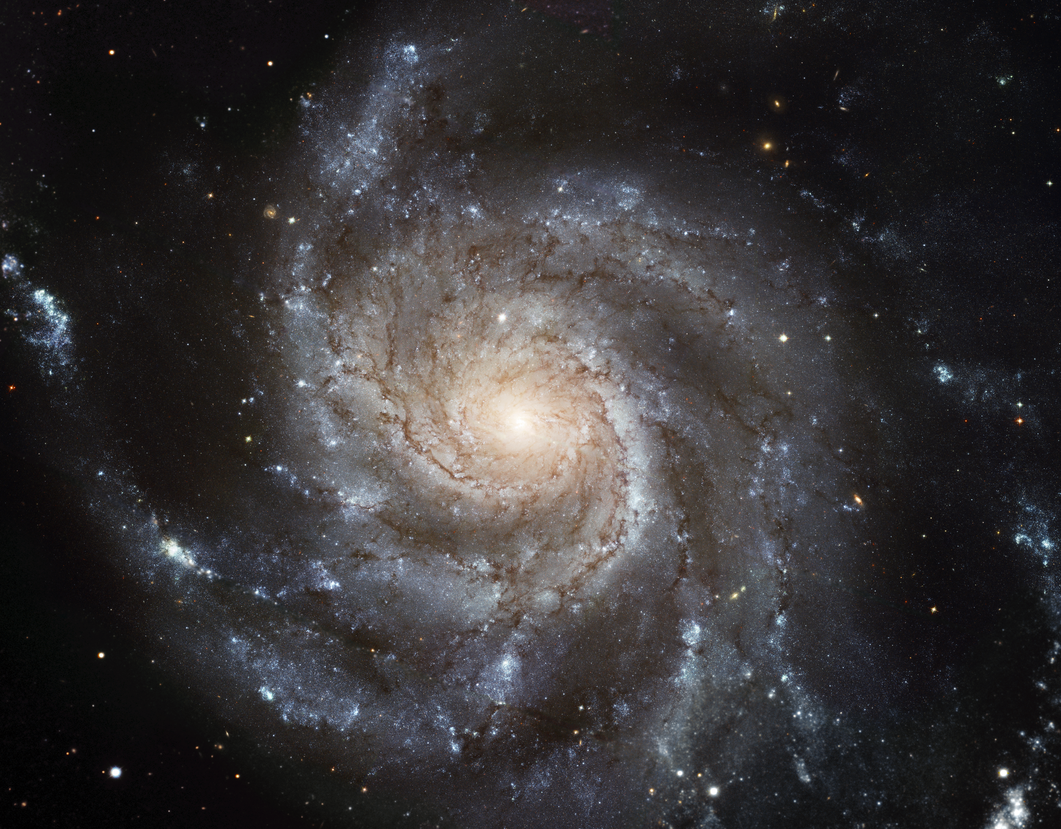
Notes:
Spiral Galaxy Messier 101
This image is one of the largest and most detailed galaxy images ever released by the NASA Hubble Space Telescope. The galaxy's spiral arms are sprinkled with large regions of star-forming nebulae. These nebulae are areas of intense star formation within giant molecular hydrogen clouds. Brilliant young clusters of hot, blue, newborn stars trace out the spiral arms. More than 50 individual Hubble images are combined into this galactic portrait.

