Slide 1
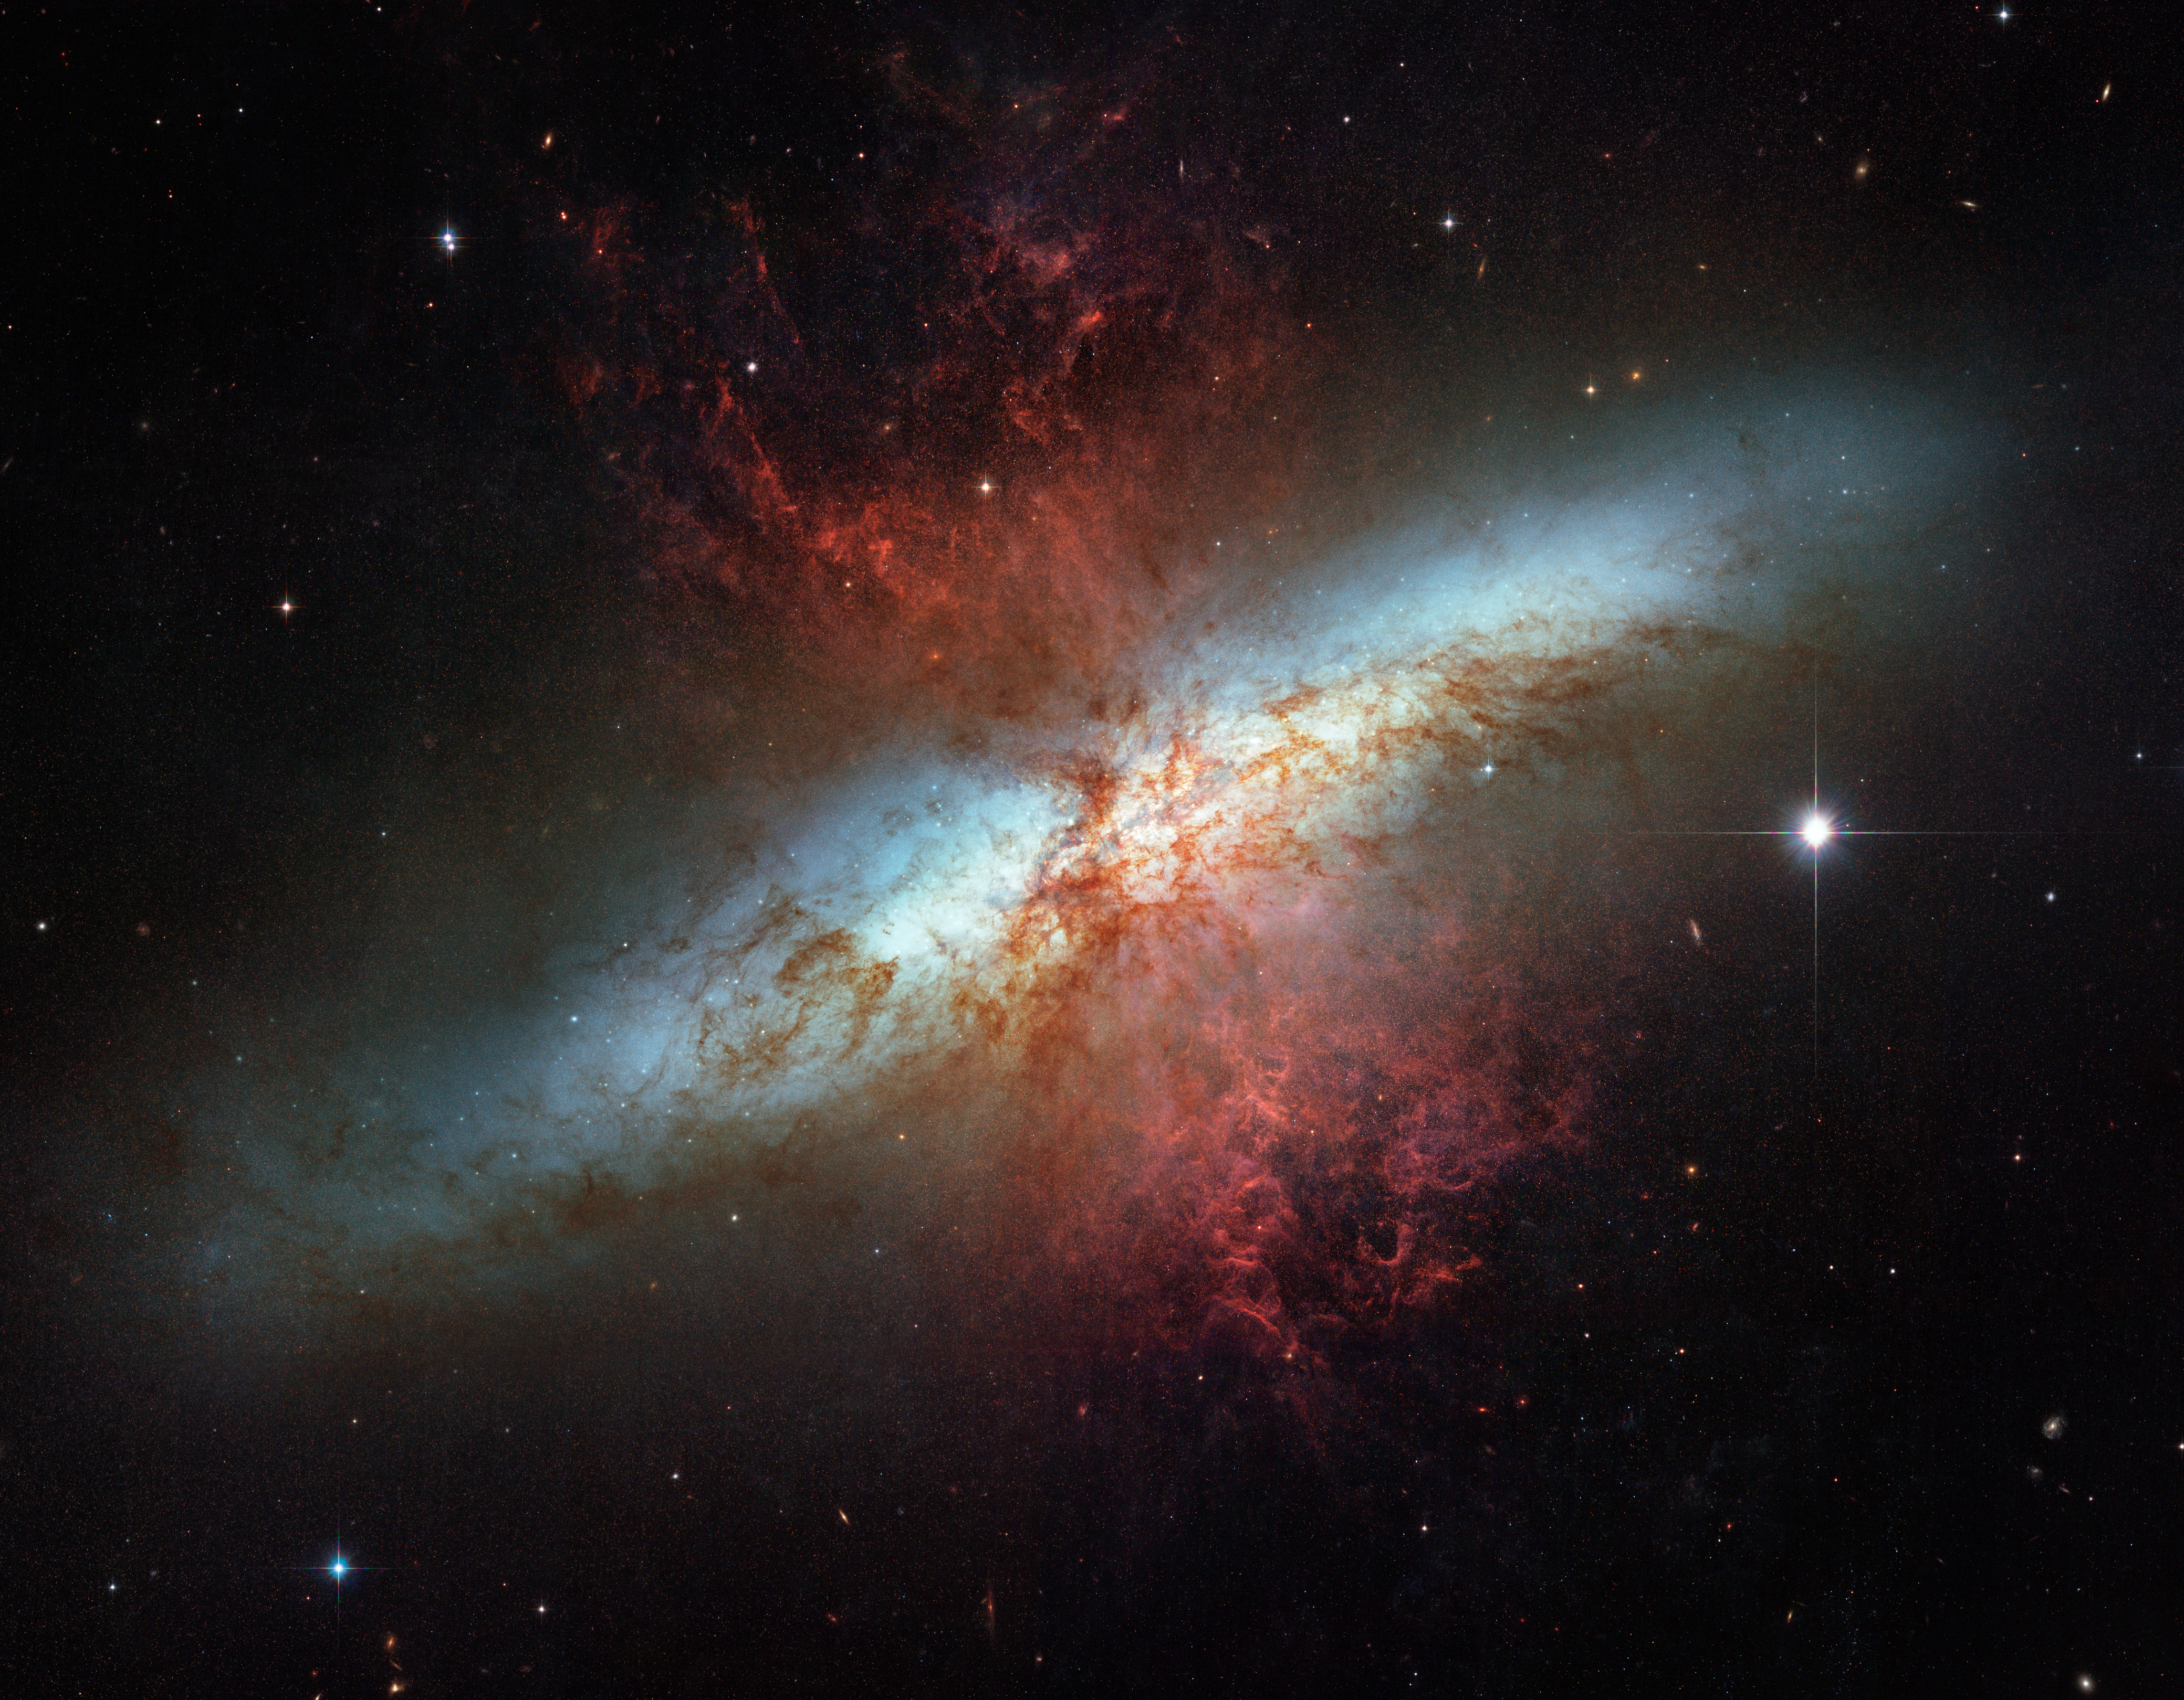
Notes:
Messier 82: A Starburst Galaxy
The NASA Hubble Space Telescope captured this view of this galaxy undergoing a period of rampant star formation. The galaxy M82 is remarkable for its bright blue disk, webs of shredded clouds, and fiery-looking plumes of glowing hydrogen blasting out of its central regions. Throughout the galaxy's center, young stars are being born 10 times faster than they are inside our entire Milky Way Galaxy. The resulting huge concentration of young stars generates a fierce galactic superwind.

