Slide 1
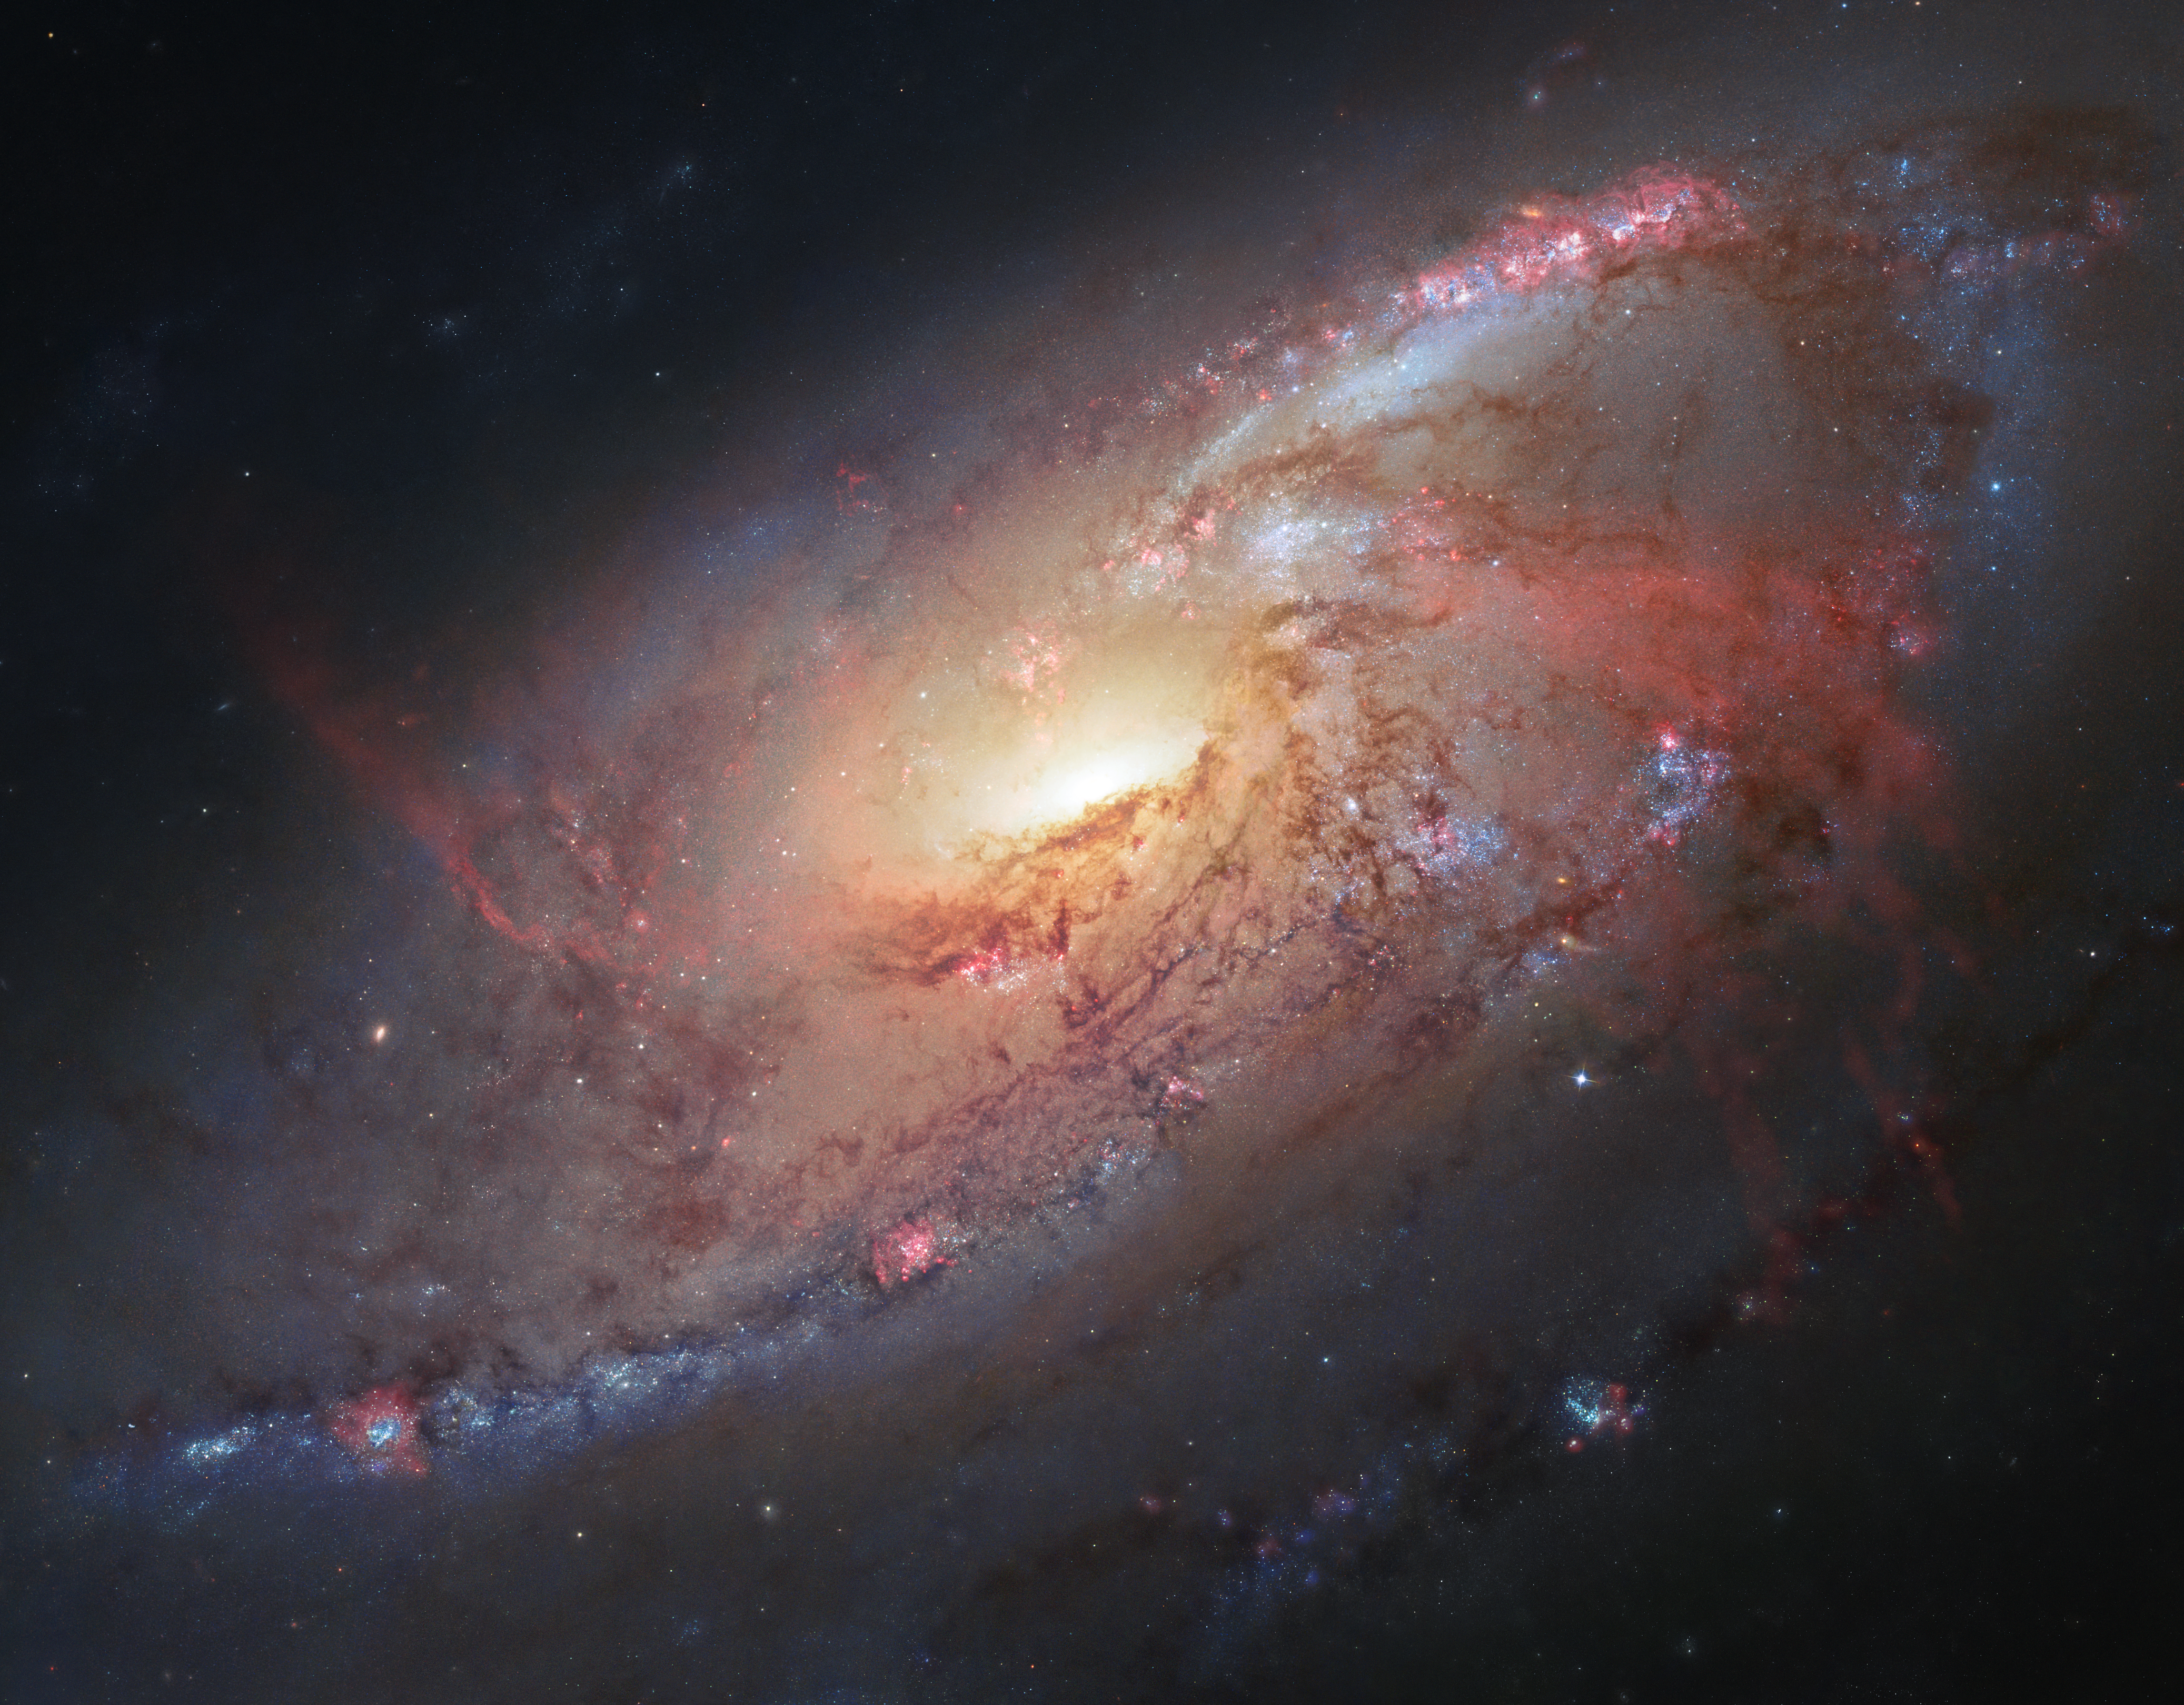
Notes:
Spiral Galaxy Messier 106
NASA Hubble Space Telescope data have been combined with ground-based images to assemble this view of the magnificent spiral galaxy M106.
This portrait of M106 contains only the inner structure around the halo and nucleus of this active galaxy. Large amounts of gas from the galaxy are thought to be falling into and fueling a supermassive black hole contained in the nucleus. The image also reveals the optical component of the "anomalous arms" of M106, seen here as red, glowing hydrogen emission.
The center of the galaxy is composed almost entirely of HST data. The outer spiral arms are predominantly HST data colorized with ground-based data taken by Robert Gendler and Jay GaBany.

